Slide 1

Data Management and Database Design
Cancer Treatment Management System
Group 8
Presented by:
Joy Gomes : 001084949
Mourya Pratap Singh : 001029868
Shalini Chandra : 001062801
Karishma Murde : 001065741

Slide 2
Problem Statement and Goals
Problem Statement
9.6 Million deaths globally in 2018 and 1 in 6 deaths is due to cancer- World Health Organization (WHO)
Need for a Cancer Treatment Information System
Goals
The purpose of the database system is to:
Store patient’s previous medical history
Current medical conditions
Appointments with Doctor
Store medicines prescribed
Keep track of patient's cancer treatment process

Slide 3
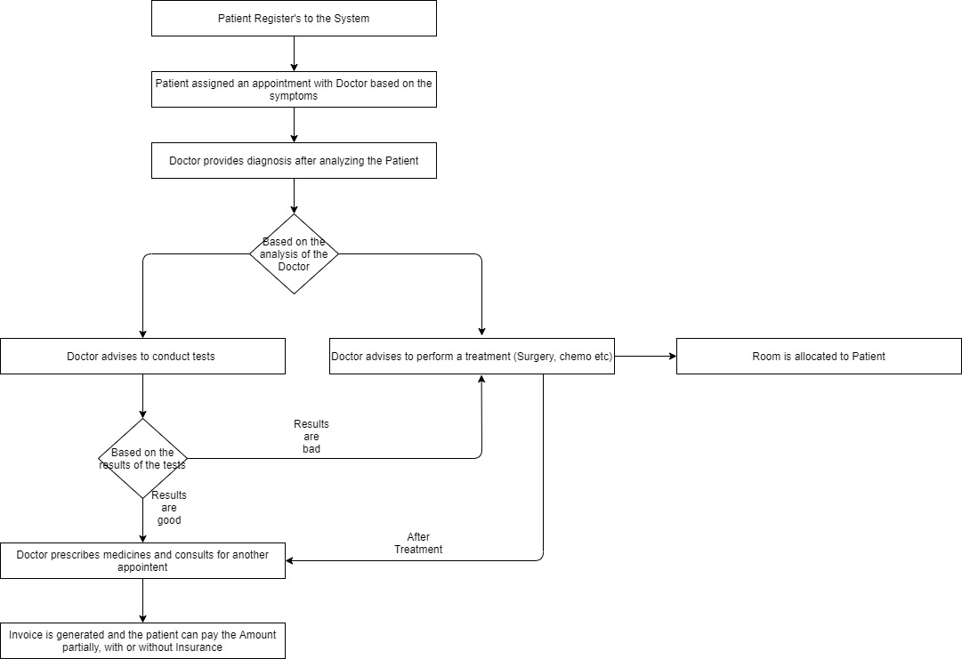
System Flow

Slide 4
Entity-Relationship Diagram

Slide 5
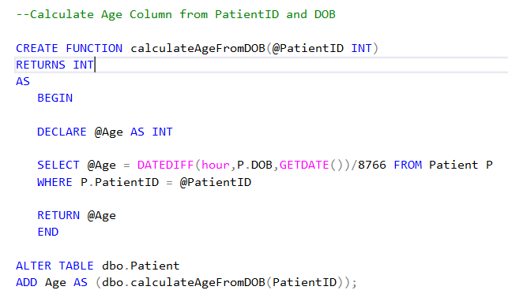
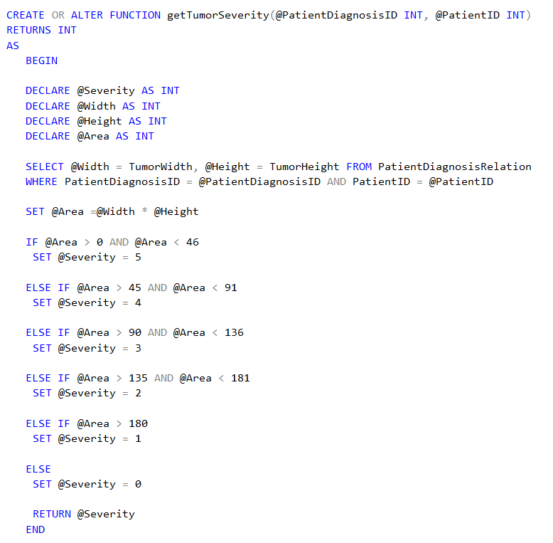
Compute Column Based on a Function
Calculate Age from Date of Birth
Populate Age Column in Patient Table from date of birth
Calculate Severity of the cancer from the tumorWidth and tumorHeight columns
Severity ranges from 1-5, where 5 being Low Severity and 1 being Critical Severity (0 being no cancer)

Slide 6
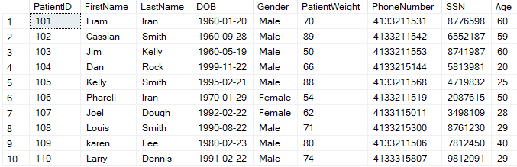
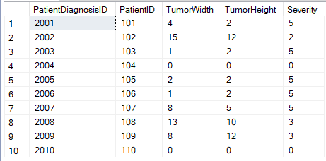
Compute Column Based on a Function (Output)
Calculate Age from Date of Birth
Calculate Severity of the cancer from the tumorWidth and tumorHeight columns

Slide 7
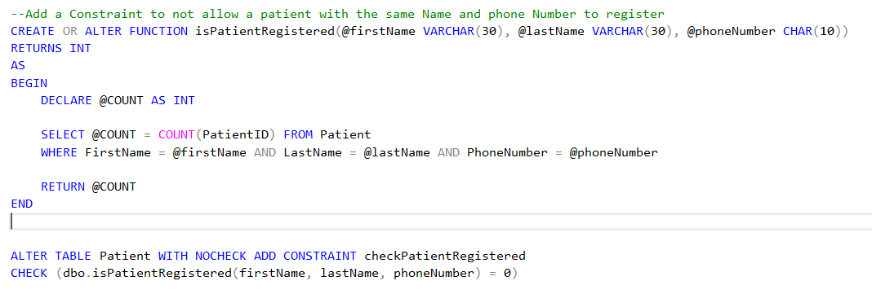
Table Level CHECK Constraint based on a function
Added constraint to not allow a patient with the same name and phone number to register.

Slide 8
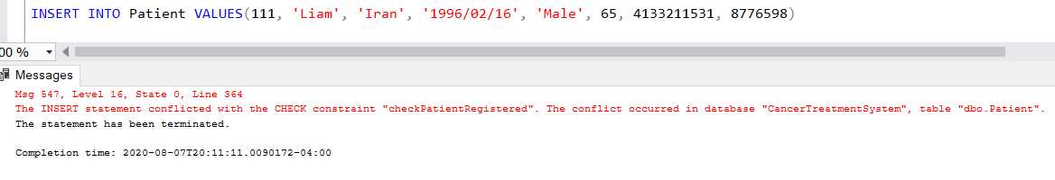
Table Level CHECK Constraint based on a function (Output)
While inserting Patient information that is already present in the database (Patient Table)

Slide 9
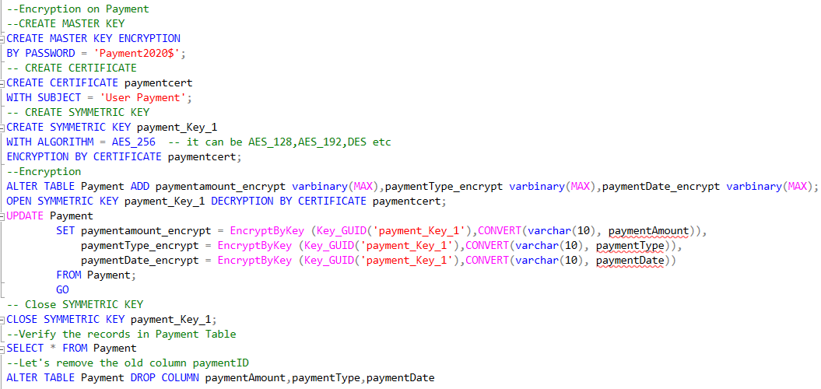
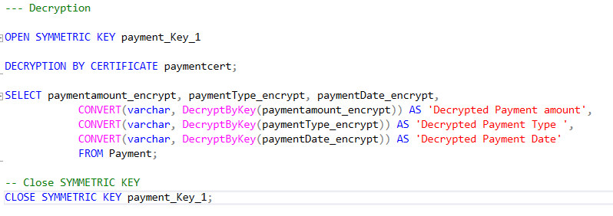
Encryption and Decryption of Payment
Encryption:
Encryption and Decryption applied on columns paymentAmount, paymentType and paymentDate.
Used Symmetic key with Algorithm AES 256.
Decryption:

Slide 10
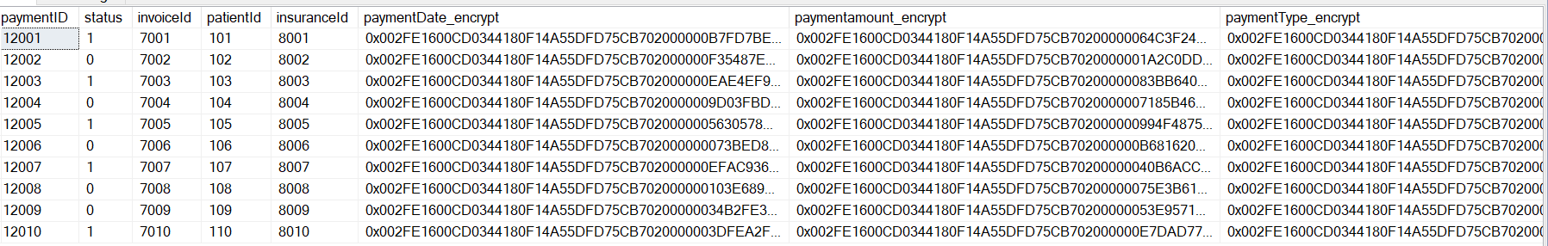
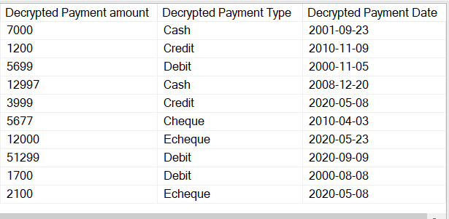
Encryption and Decryption Output

Slide 11
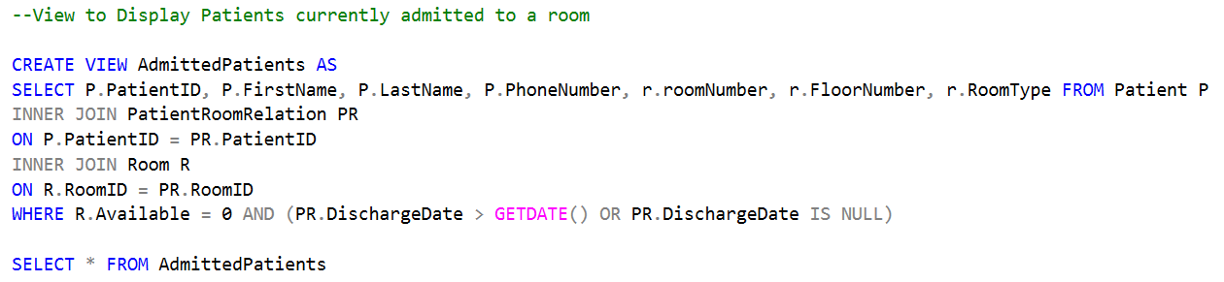
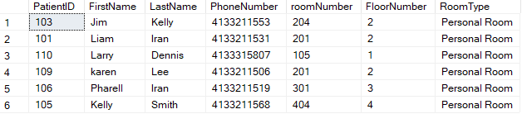
Views
Output:

Slide 12
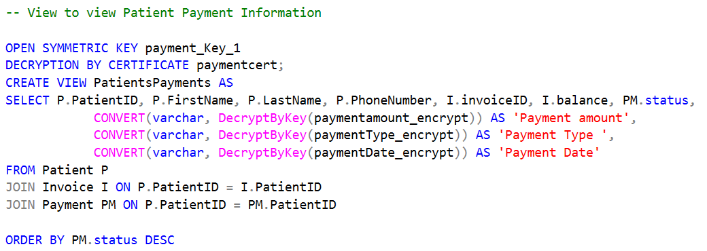
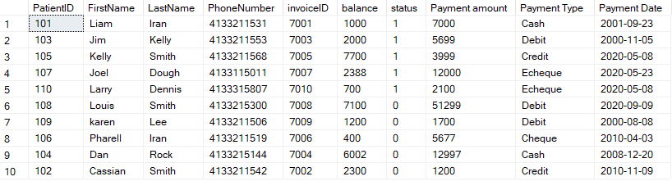
Output:

Slide 13
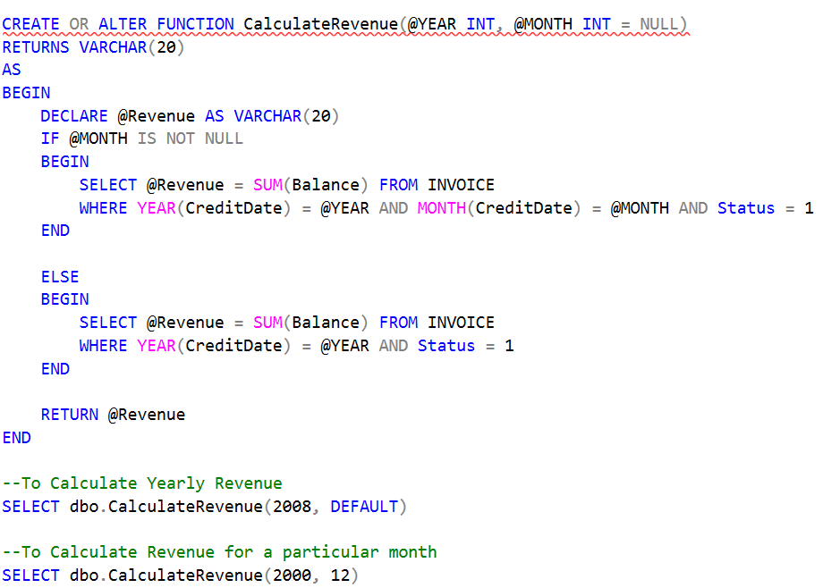


Function (to calculate revenues)

Slide 14
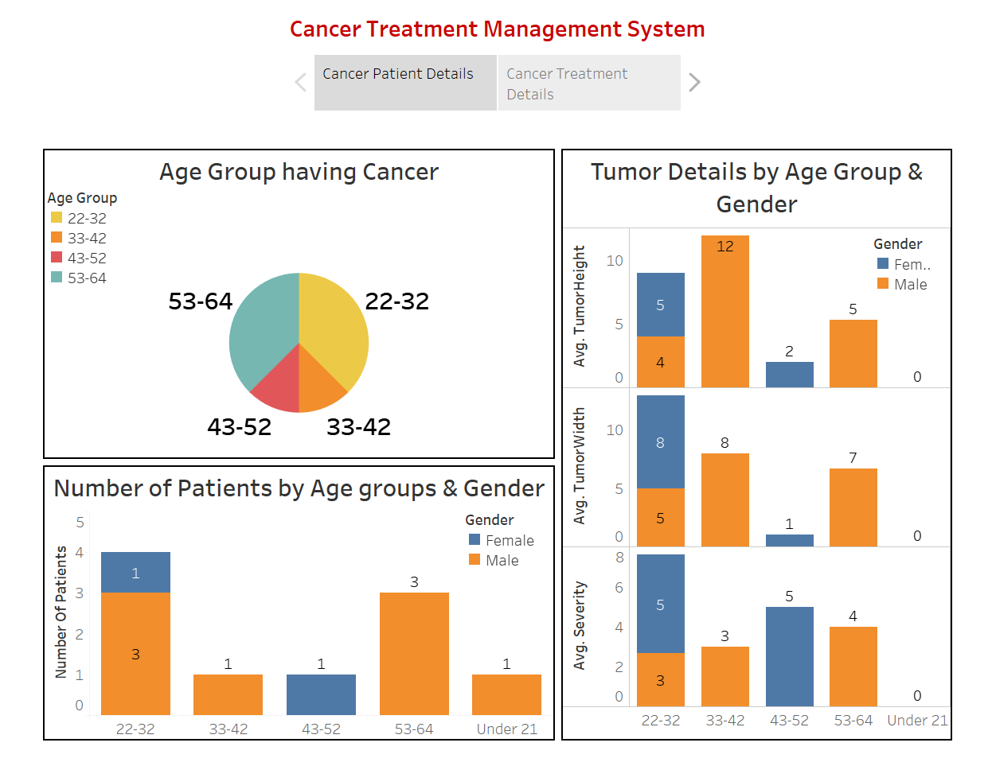
Visualization

Slide 15
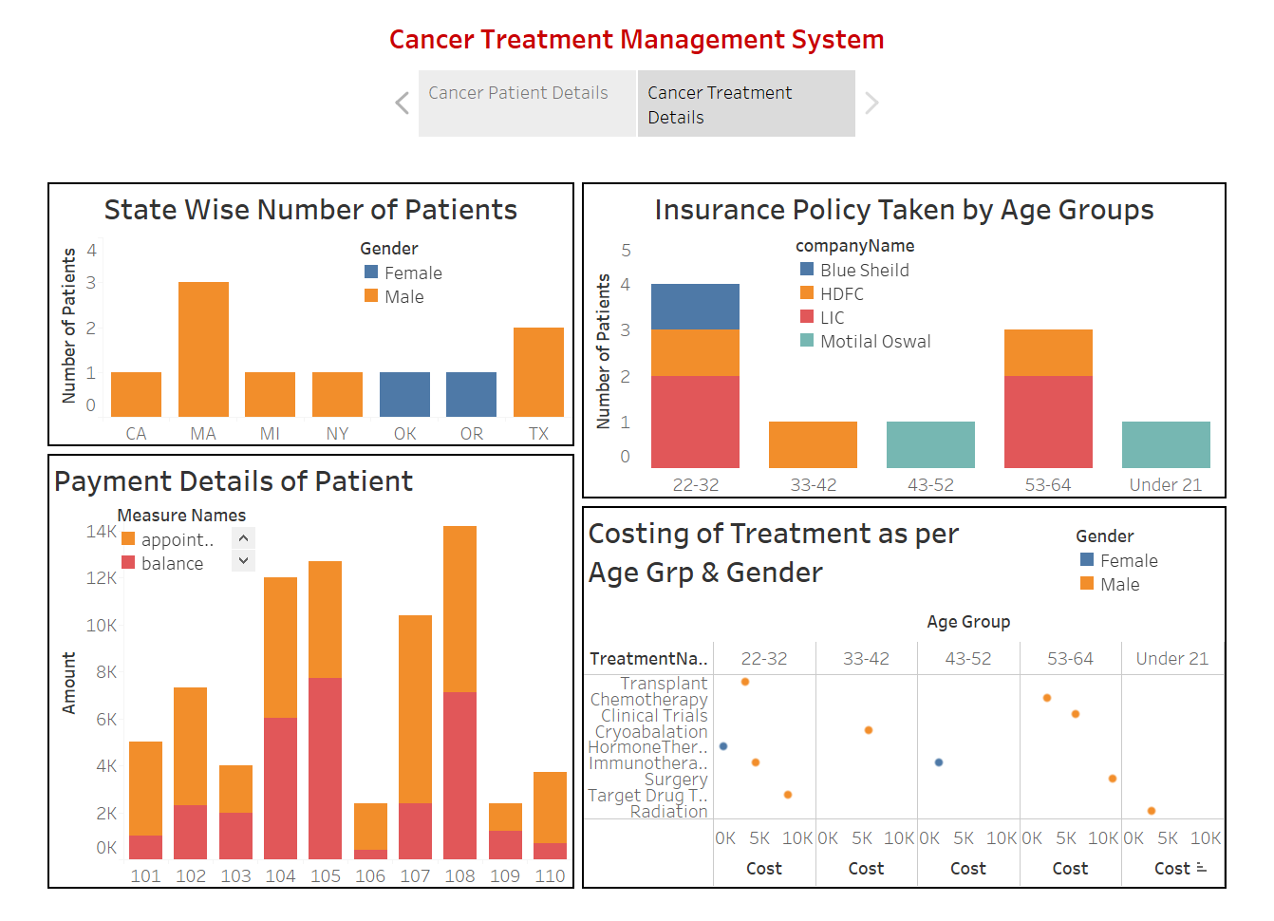
Visualization

Slide 16

Any questions ?

Slide 17

Thank you

